Slide 1


A Data Driven Approach to Predict the Success of Bank Telemarketing
Michael Bankole
Introduction to Data Science Capstone Project

Slide 2


The Problem, Solution, Clients and Motivation
The Problem
Portuguese banks were pressured to increase capital requirements i.e. by capturing more long term bank deposits through telemarketing:
They need to contact thousands of clients for telemarketing
They could or need to contact a client multiple times
They have a target:
Time constraints
Clients intrusiveness:
Not to disturb people with calls
How to solve this problem
Under this growing pressure, the use of a decision support system (DSS) will be a valuable tool
Below is A telemarking view

Slide 3
A support client selection decision system for the Portuguese bank campaign managers
An algorithm been developed to predict the result of a telemarketing phone call of clients who will be interested in buying the long term deposit
Who cares?
Basically the Portuguese bank
This idea can also be used by:
Any banking system around the world
Any organization that reach out to people for marketing purpose in any part of the world and
Many more
Why this project?
To help find a solution to the growing problem facing target optimization for telemarketing within the Portuguese bank, any banking industry or marketing firm
- To help reduce pressure facing telemarketing campaign managers
- To help the Portuguese bank or any marketing firm increase profits and reduce costs

Slide 4
Project formulation and the Data
Project formulation
Steps taken for the project process:
I framed the problem i.e. client, what problem to solve, translated the problem well-defined problem
I collected the raw data needed to solve the problem i.e. worked on the data to use the useful parts
I processed the data i.e. data wrangling and cleaning
I explored the data i.e. performed some exploratory analysis on the dataset
I performed in-depth analysis i.e. machine learning, statistical models, algorithms e.t.c
Communicate results of the analysis i.e. data storytelling

Slide 5
The Data
Dataset description:
Portuguese banking institution direct marketing campaign dataset
UCI Machine Learning Repository as a csv file
The data is collected from May 2008 to November 2010
90% of it being the training set (41188 instances)
10% testing set (4119 instances)
2. The data attributes are divided into five sections:
Bank client data attributes (age, job, marital, education, default, housing, and loan)
Related with the last contact of the current campaign attributes (contact, month, day_of_week, and duration)
Other attributes (campaign, pdays, previous, and poutcome)
Social and economic context attributes (emp.var.rate, cons.price.idx, cons.conf.idx, euribor3m, and nr.employed) and
Output variable: desired target (y)

Slide 6
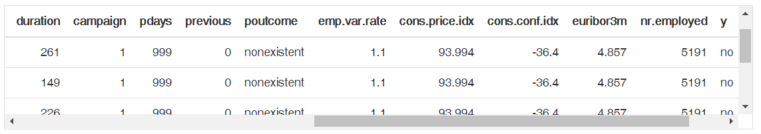
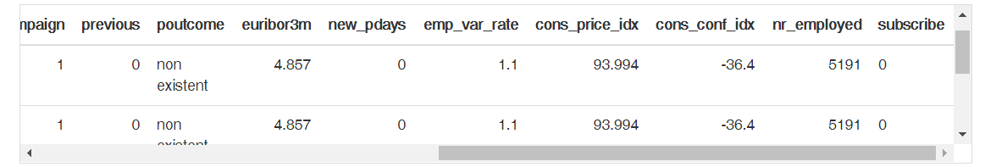
Data wrangling
A view of the dataset head
A view of the cleaned dataset head

Slide 7
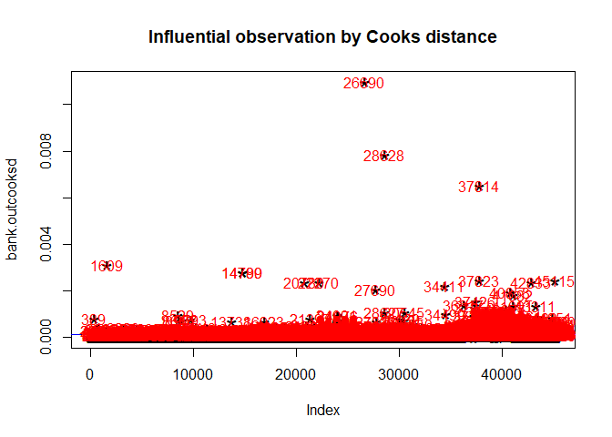
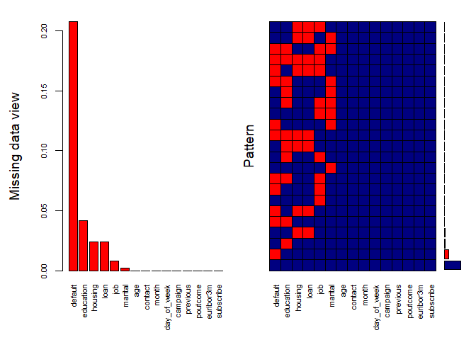
Cooks Distance
Using Cooks Distance method to detect all outliers in the dataset
Missing Pattern Plot

Slide 8
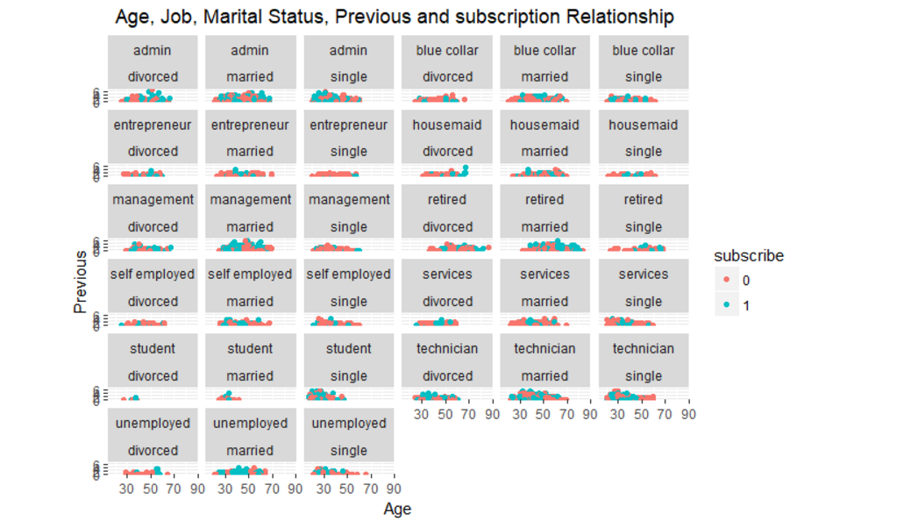
Exploratory analysis

Slide 9
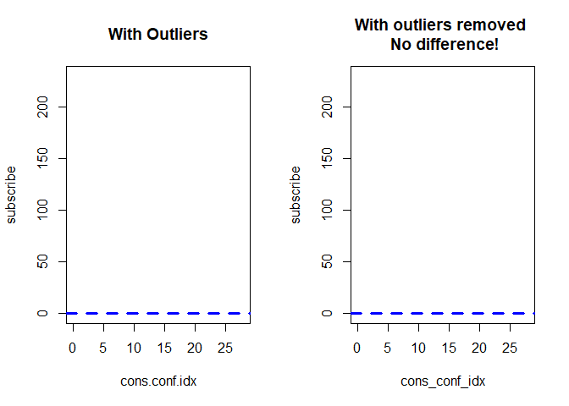
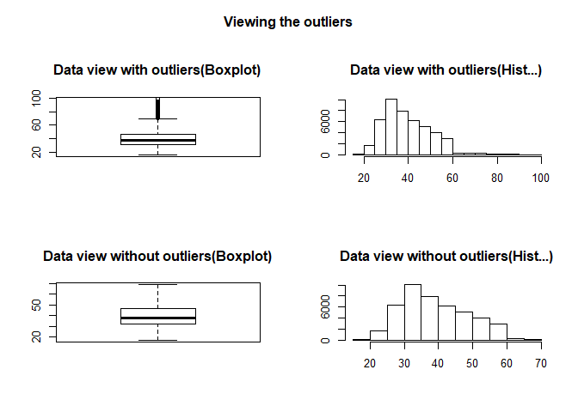
Model fit check
This checks how the model will fit for the cons_conf_idx variable in the analysis
Before and after the outlier Plot

Slide 10
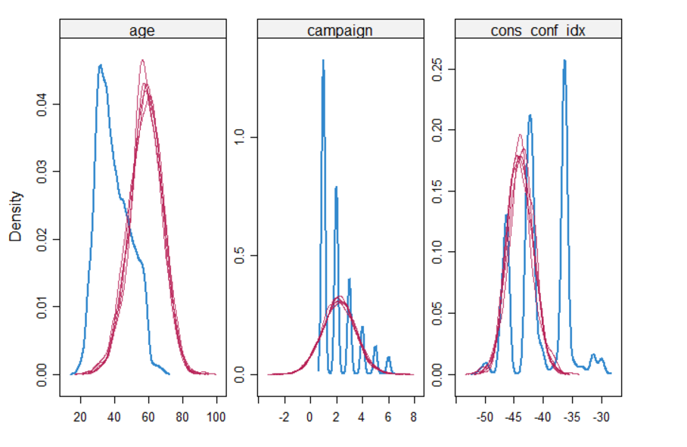
Density plot

Slide 11
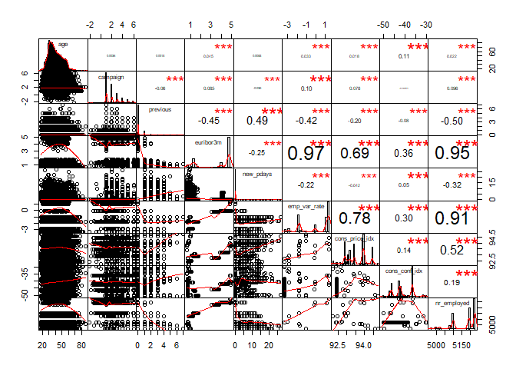
Correlation graph with histogram using the spearman method

Slide 12
Machine Learning
Model Overview
Characteristics of the model used in this project:
This project is a supervised problem
It is a classification problem
The outcome variable is binary
Four binary classification data mining (DM) models was used to build a predictive model:
Logistic regression (LR)
Decision trees (DTs)
Rpart (CART) and
Random forest (RF)
Also, a cross validation (10 fold cv) method was used on the rpart in building this models

Slide 13
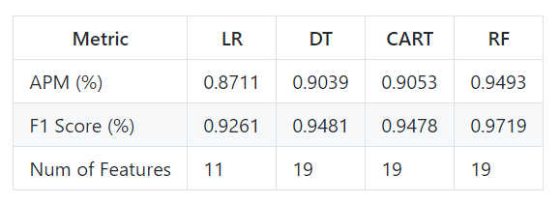
Metrics
Metric Comparison
Chosen model
Why this model
Right model for this analysis, I chose the RF because:
It presented the best results (APM = 95% and F1 Score = 97%)
It provides the highest rate of accuracy compared to other models
It gives the least error rate compared to other models

Slide 14
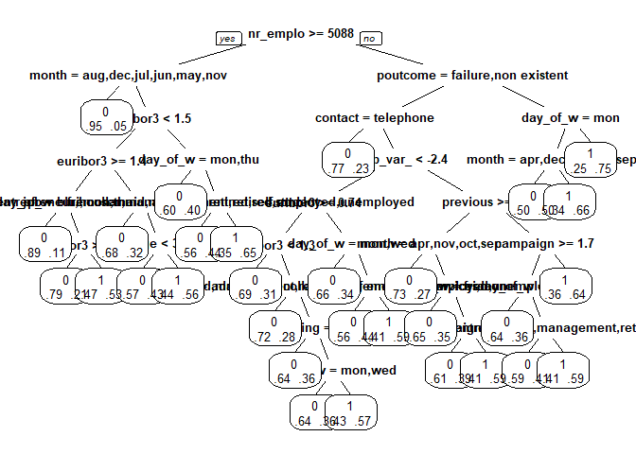
Model outcome

Slide 15
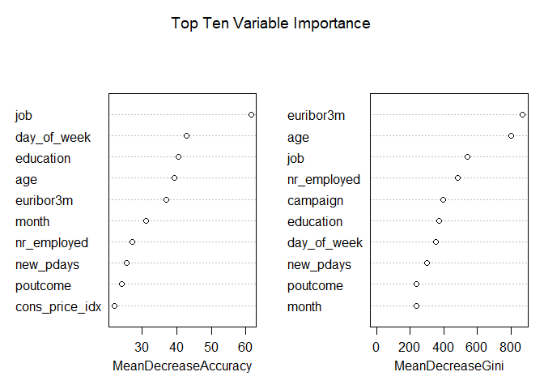
Feature importance

Slide 16
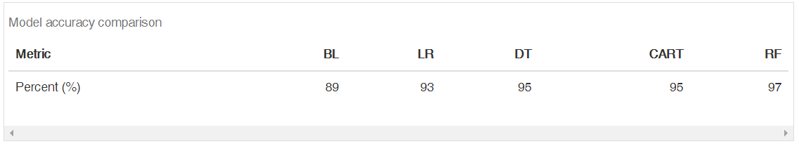
Model accuracy
Accuracy Comparison
Client recommendations
Recommendations
Based on the models being built, I will like to give the following recommendations to my client :
Bank campaign managers will be advised to first target only the most likely buyers of the long term deposits based on the model prediction.

Slide 17
Client recommendations Contd.
Recommendations
Bank campaign managers will be advised based on the decision tree by:
using a sensitivity analysis
ranking the input attributes and showing the average effect of the most relevant features. i.e. learning the CART model responses with a low error rate and allowing the extraction of decision rules that are easy to interpret
Bank campaign managers will be advised to focus on the top ten RF important variables based on the sensitivity analysis results i.e. this could help them know and understand how to relate with each customer they will be selling the bank term deposit to, leading to more success in the campaigns

Slide 18
Suggestions and Conclusion
Recommendations
Suggestions for future improvement:
This models could be improved on by doing some further feature engineering on the dataset. i.e. categorizing the age, also, reducing or merging up some of the education categories e.t.c.
Some of the features in this dataset could be worth more exploring. i.e. the social and economic context attributes are very essential to the models and they could be further analysed
New valuable knowledge could also be possibly provided to improve model accuracy i.e. adding some new features
Conclusion:
Using machine learning could help reduce pressure and increase efficiency in telemarketing
It will help the Portuguese bank to have an efficient campaign improvement i.e. reducing pressure, reducing client intrusiveness, and being cost effective
It could help achieve more success when compared with the based bank practice

Slide 19
Special Thanks to my mentor: Srdjan Santic!!!
Thank you everyone!!!

